Slide 1



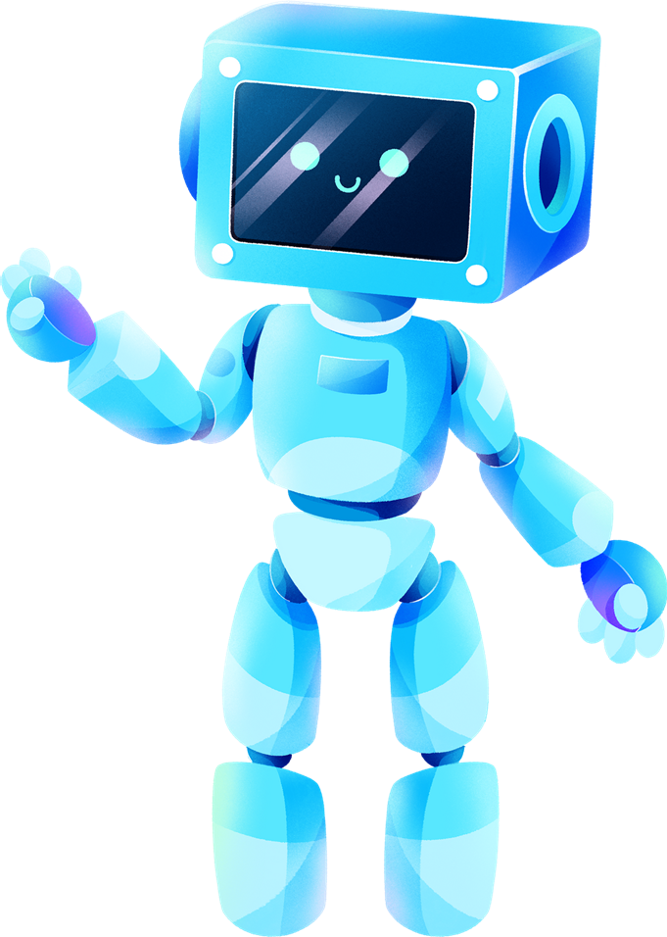




CSA0491 -Operating Systems for Process Scheduling
Web Crawler using Python
Project by,
D.Ajay Kumar,A.Bhargav,A.Ajaykumar
(192211089,192110283,192224154)
Operating Systems
SSE,SIMATS
Guided By,
Dr. G Mary Valantina
(Course Faculty)
Operating Systems
SSE, SIMATS

Slide 2


ABSTRACT
The Web Crawler project involves the creation of a Python-based tool that traverses websites, extracts relevant data , and presents it in a structured manner. Using state-of-the-art libraries like BeautifulSoup and requests, our crawler ensures efficient and accurate data extraction. The project’s primary focus is on user accessibility and ease of integration with our systems. By prioritizing a user-friendly interface , our crawler aims to enhance the overall experience , allowing users to interact seamlessly with the extracted data. Furthermore, the project’s emphasis on integration aligns with our broader goal of providing a versatile tool that harmonizes effortlessly with existing system, fostering a more cohesive and streamlined data retrieval process.
Keywords : Web Crawler, Python-based, BeautifulSoup, Data retrieval

Slide 3



INTRODUCTION
Web crawlers play a pivotal role in the vase realm of information retrieval on the internet.
They are automated programs designed to systematically navigate through the web,collecting data and indexing information for search engines.
Our project aims to develop an efficient and user-friendly web crawling tool. In this era of information explosion the need for web crawlers is paramount
Web crawlers simplify the process of gathering and organizing data from diverse online sources
Academic research, business Intelligence , or data analytics this web crawler will be very reliable and efficient

Slide 4
HARDWARE & SOFTWARE REQUIREMENTS
HARDWARE :
PROCESSOR : AMD Ryzen 7 5700U with Radeon Graphics 1.80 GHz, 64-bit operating system, x64-based processor
STORAGE : 512GB SSD
MEMORY : 8GB RAM
GRAPHIC CARD : IN-BUILT RADEON GRAPHICS
SOFTWARE :
OS : WINDOWS 10/11
PYTHON : 3.12.6
INTEGRATED DEVELOPMENT ENVIRONMENT (IDE) :
Visual Studio Code
PACKAGE :
Requests Library for HTTP request
BeatifulSoup Library for HTML parsing
Tkinter Library for GUI

Slide 5
EXISTING SYSTEM
Existing web crawlers often face challenges such as inefficiency in handling dynamic content, difficulty in parsing complex HTML structures, and limited customization options
By incorporating intelligent parsing algorithms, we overcome the challenges posed by intricate HTML structures, enabling precise data retrieval even in complex web environments
The project stands out with its emphasis on customization, offering users the flexibility to tailor the crawler's behavior to specific needs, thereby enhancing its adaptability .
As a result our web crawler solution not only tackles existing challenges head-on but also sets a new standard for efficiency, accuracy, and user-driven customization

Slide 6
PROPOSED SYSTEM
Design of a versatile web crawling solution capable of addressing a wide range of domains and website architectures
Adaptable to evolving web technologies and able to accommodate changes in website structures over time
Integration of customization options, allowing users to define and tailor the crawler’s behavious based on specific requirements.
Flexible configuration settings for data extraction, enabling users to fine-tune the system according to their unique use cases

Slide 7
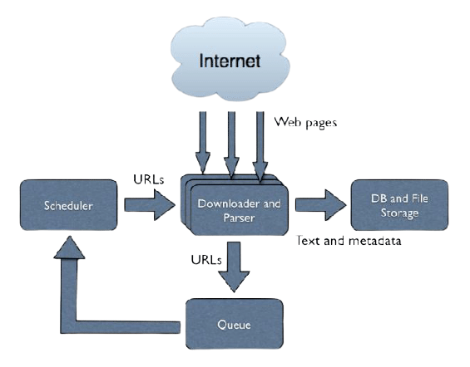

ARCHITECTURE
Web pages
Url’s
Text and metadata
Url’s

Slide 8
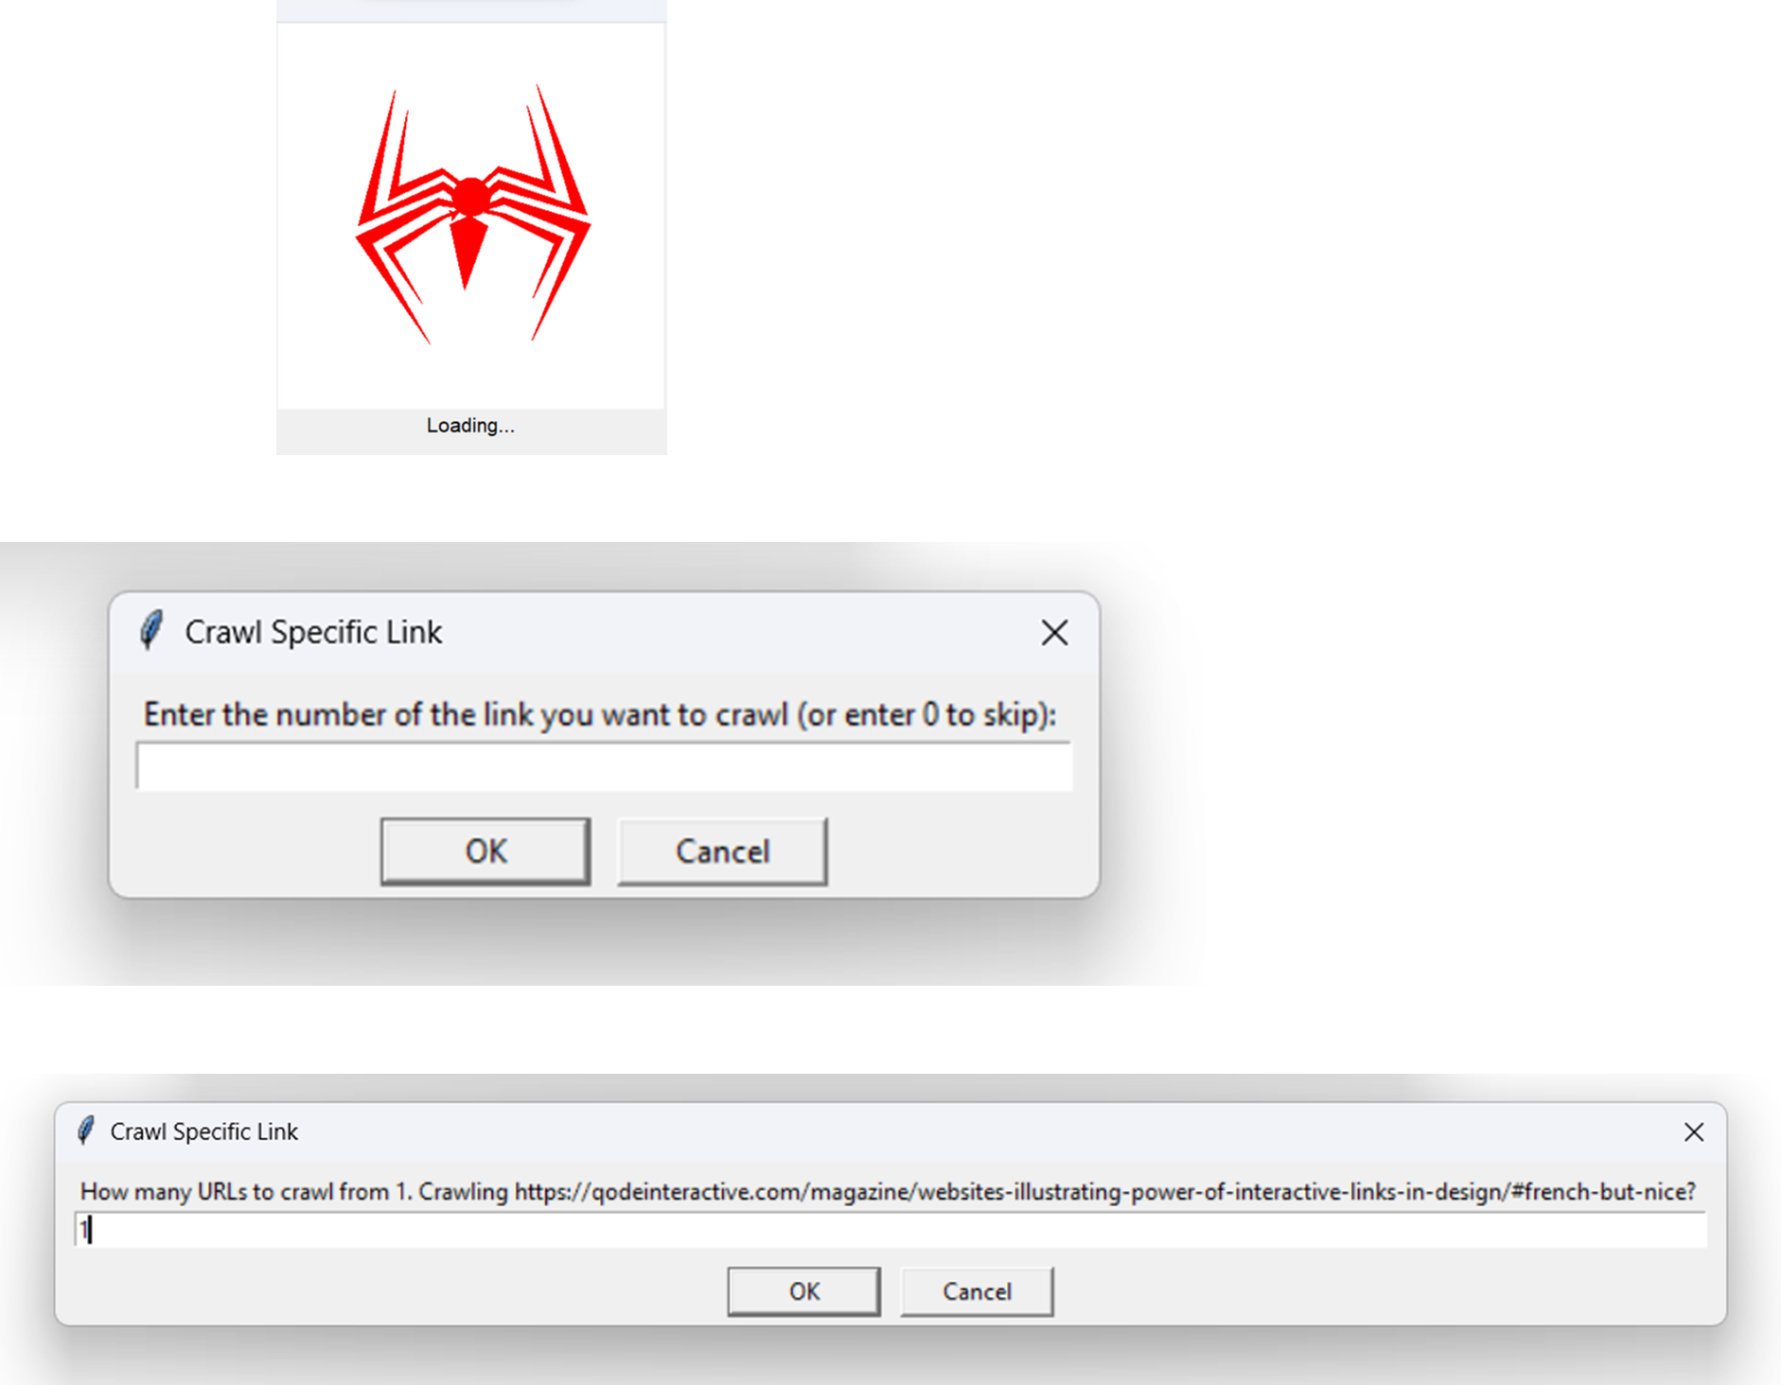
DESIGN

Slide 9

TESTING

Slide 10

IMPLEMENTATION

Slide 11
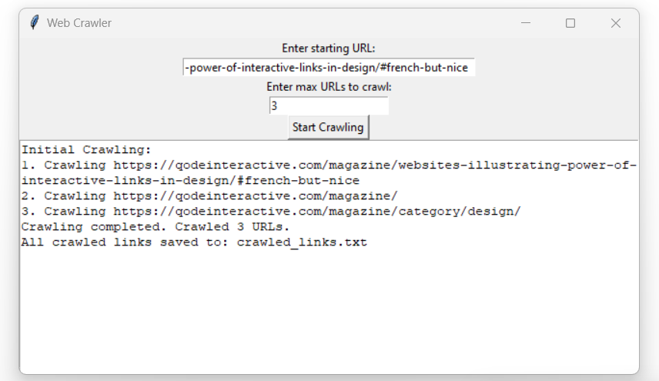
FINAL OUTPUT

Slide 12
CONCLUSION
In conclusion, our Web Crawler project stands as a testament to its effectiveness in addressing the shortcomings of existing systems, offering users a robust and adaptable tool for data extraction from the vast expanse of the web. Its reliability and customization options make it a versatile solution, catering to diverse needs across different applications. With the ability to overcome limitations, our crawler empowers users with a seamless and efficient means of harvesting valuable data from the ever-evolving landscape of the internet.

Slide 13
FUTURE SCOPE
Implementing multithreading for faster crawling.
Enhancing GUI for more advanced customization.
Integrating natural language processing for better content extraction.
Develop mechanisms for real-time monitoring and adaptation to changes in website structures.
Integrate machine learning algorithms to prioritize content based on relevance, user preferences, or historical data.

Slide 14
LITERATURE SURVEY
In conclusion, our Web Crawler project stands as a testament to its effectiveness in addressing the shortcomings of existing systems, offering users a robust and adaptable tool for data extraction from the vast expanse of the web. Its reliability and customization options make it a versatile solution, catering to diverse needs across different applications. With the ability to overcome limitations, our crawler empowers users with a seamless and efficient means of harvesting valuable data from the ever-evolving landscape of the internet.

Slide 15



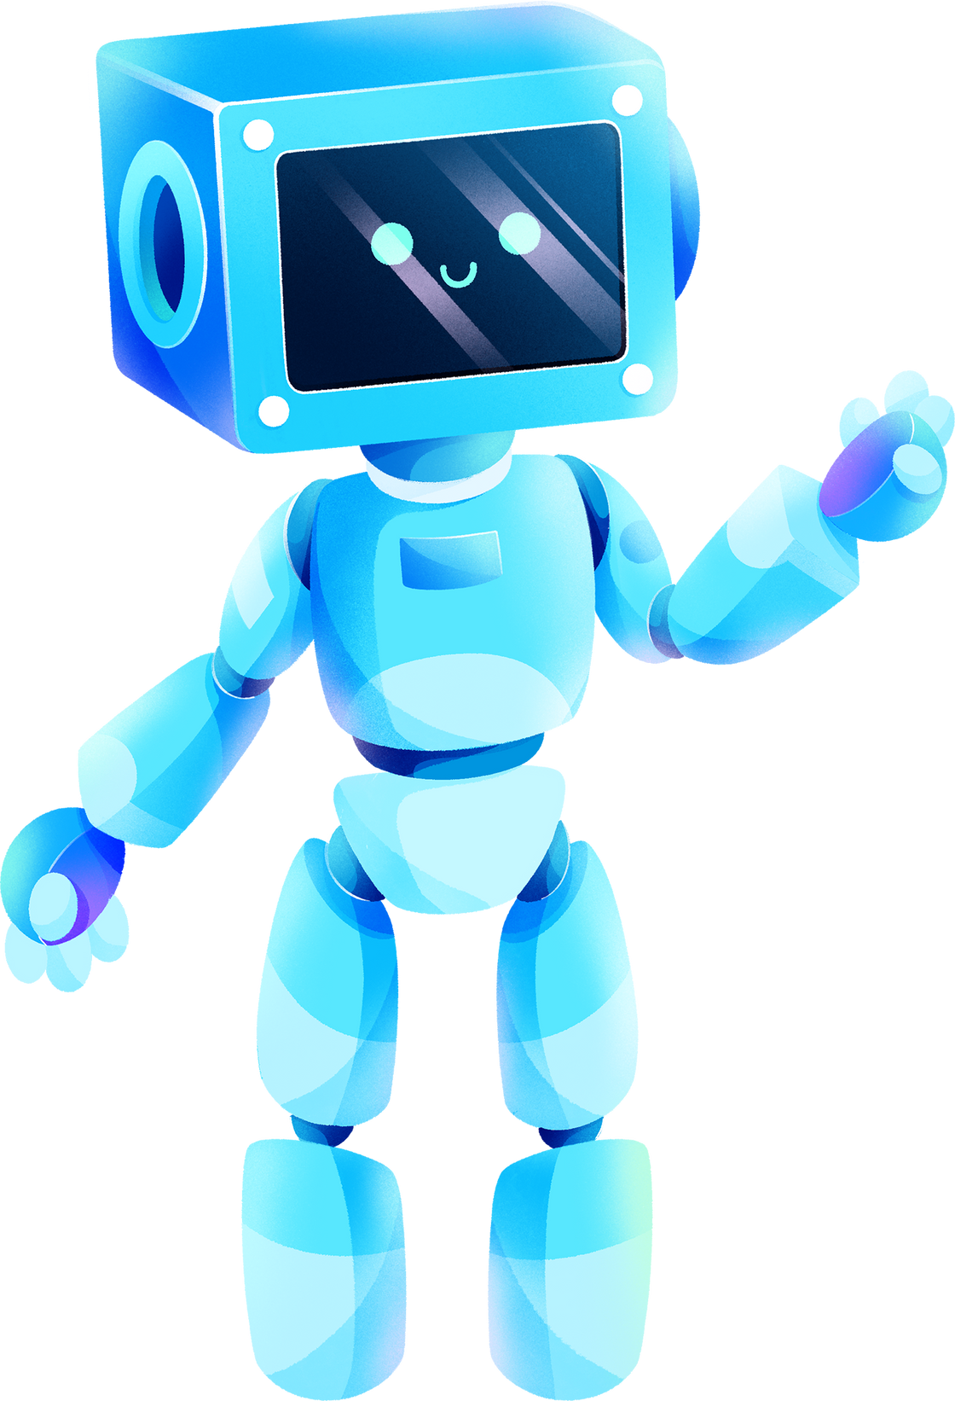

REFERENCE
[1] Python Software Foundation. (n.d.). Python: A dynamic, interpreted, open-source programming language. Retrieved from https://www.python.org/
[2] Python Software Foundation. https://www.python.org/
[3] Richardson, L., & Lieb, H. O. (2013). Web Scraping with Python: A Comprehensive Guide. O'Reilly Media.
[4] Harwani, B. (2017). Tkinter GUI Programming by Example. Packt Publishing.
[5] Zelle, J. M. (2005). Python Programming: An Introduction to Computer Science. Franklin, Beedle & Associates Inc.

Slide 16


THANK YOU!
TEAM MEMBERS:
D.AJAY KUMAR, A.BHARGAV, A.AJAY KUMAR
REGISTER NUMBER :
192211089,192110283,192224154

